Slide 1
Determinants of Domestic
In-Migration Across US States
Multiple Linear Regression · MLR · Stepwise AIC Selection
48
11
MLR
(Stepwise)AIC
US States
Predictors
Method
Selection
MSc Statistics — Semester 2 | Academic Year 2025–26
Shubham Chavan (2514) · Tejal Take (2553) · Prajakta Gaikwad (2518)

Slide 2
Data Deconstruction — 10 Candidate Predictors of Migration
TARGET
VARIABLE
Economic Drivers
Socio-Demographic
Environmental & Geographic
Unemp
Unemployment rate (%)
Crime
Crime rate per 100,000
Temp
Mean annual temp (°F)
NDIR
Wage
Avg. hourly wage ($/hr)
Metrop
% in metro areas
Region
Categorical: Midwest
Northeast · South · West
Net Domestic
In-migration
Rate per 1,000
residents
→
Income
Per-capita income ($)
Educ
% HS graduates
Poor
% below poverty line
BusFail
Business failure rate
Taxes
Per-capita state tax ($)
Y (Response)

Slide 3
Data Description — Variables & Dataset Overview
Variable | Description | Role | Type | Range
NDIR | Net domestic in-migration rate (per 1,000 residents) | Response (Y) | Continuous | −45.5 to +128.5
Unemp | Unemployment rate (%) | Predictor | Continuous | 3.2 – 8.6
Wage | Average hourly wage ($/hr) | Predictor | Continuous | 7.3 – 14.2
Crime | Crime rate per 100,000 residents | Predictor | Continuous | —
Income | Per-capita personal income ($) | Predictor | Continuous | —
Metrop | % population in metro areas | Predictor | Continuous | —
Poor | % population below poverty line | Predictor | Continuous | —
Taxes | Per-capita state tax ($) | Predictor | Continuous | —
Educ | % high school graduates | Predictor | Continuous | —
BusFail | Business failure rate | Predictor | Continuous | —
Temp | Mean annual temperature (°F) | Predictor | Continuous | —
Region | Geographic region (Midwest / NE / South / West) | Predictor | Categorical | 4 levels
n = 48 contiguous US states

Slide 4
Research Objectives
4
01
Identify Key Determinants
04
Validate Assumptions & Improve Fit
Determine which socio-economic and geographic factors significantly influence domestic in-migration rates across US states.
Check MLR assumptions (normality, homoscedasticity, independence), detect outliers, and refit the model for better reliability.
02
Build a Predictive Model
05
Compare Models
Develop a Multiple Linear Regression (MLR) model to quantify the relationship between NDIR and predictor variables.
Compare the full model and stepwise model using R², Adjusted R², AIC, and ANOVA to select the best-fitting model.
03
Variable Selection via AIC
Apply Stepwise AIC selection (bidirectional) to identify the most parsimonious model with optimal predictive performance.
Determinants of Domestic In-Migrants | PRMSS Statistics Sem II | 2025–26

Slide 5
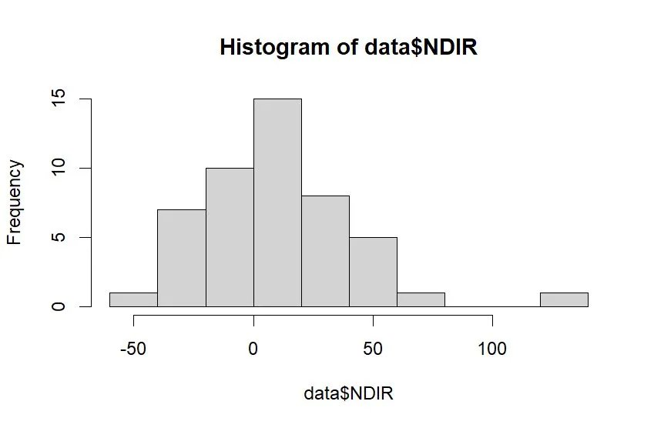
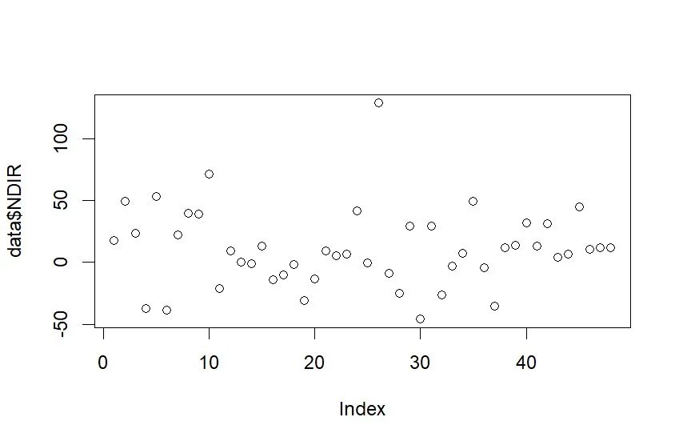
Exploratory Data Analysis — Distribution of NDIR
Histogram of NDIR
Index Plot of NDIR (48 States)
10.89
9.25
128.5
−45.5
34.2
Mean NDIR
Median
Max (Nevada)
Min (New York)
Std. Dev.
Histogram
Index Plot
Right-skewed; most states cluster 0–50. Nevada (+128.5) is a clear high outlier; New York (−45.5) at far left. Bulk of NDIR follows approximate normality when excluding outliers.
No systematic trend by state number. Obs 26 (Nevada) is far above all others. Variability appears roughly homogeneous, confirming cross-sectional nature of data.

Slide 6
Exploratory Data Analysis
5
Key Findings from EDA
▸ NDIR ranges from −45.5 to +128.5, indicating high variability in migration patterns across states.
▸ The distribution of NDIR is right-skewed; most states have moderate or slightly positive migration rates.
▸ Western states tend to have highest in-migration; Northeastern states show net out-migration.
▸ Histogram reveals potential outliers at extreme ends — California (−37.2) and Nevada (+128.5).
Determinants of Domestic In-Migrants | PRMSS Statistics Sem II | 2025–26

Slide 7
Why Multiple Linear Regression?
①
Multiple Predictors
②
Quantify Effects
③
Continuous Response
Migration is driven simultaneously by economic, social, and environmental factors. Simple regression cannot capture joint effects — MLR models all predictors together, isolating each predictor's contribution while holding others constant.
MLR provides estimated regression coefficients (β) for each predictor, enabling us to say: 'Holding all else equal, a $1 increase in per-capita taxes reduces NDIR by β units.' This is essential for policy inference.
NDIR is a continuous numeric variable. MLR is the natural choice over logistic regression (which requires binary outcomes) or other methods that do not apply to continuous responses.
④
Mixed Predictor Types
⑤
Interpretability
⑥
Statistical Inference
Our dataset contains both continuous variables (Income, Taxes, Temp…) and a categorical variable (Region). OLS MLR handles this seamlessly through dummy variable encoding of Region.
MLR coefficients have direct, intuitive interpretations for policy-makers and researchers. Non-parametric or ML methods may outperform on prediction, but lack this transparency.
OLS provides t-tests for each coefficient and an F-test for overall model significance, allowing us to rigorously test which factors statistically significantly predict migration.

Slide 8
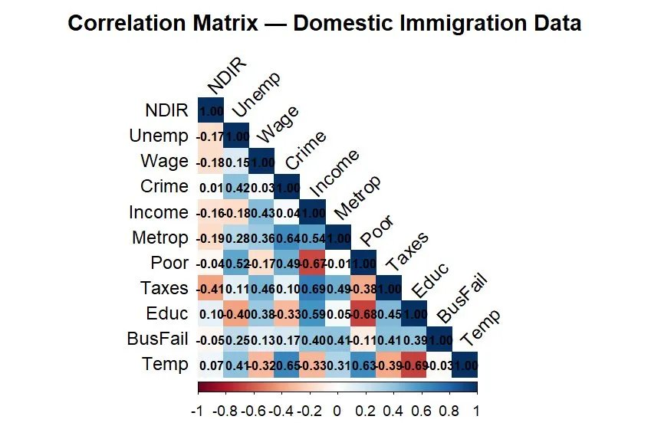
Pairwise Correlation with NDIR — Pearson Coefficients
Predictor | r with NDIR | Direction | Strength
Taxes | −0.407 | Negative | Moderate ★★
Metrop | −0.186 | Negative | Weak
Unemp | −0.173 | Negative | Weak
Wage | −0.180 | Negative | Weak
Income | −0.158 | Negative | Weak
Poor | −0.037 | Negative | Negligible
BusFail | −0.046 | Negative | Negligible
Temp | +0.075 | Positive | Negligible
Educ | +0.103 | Positive | Negligible
Crime | +0.007 | Positive | Negligible
Correlation Matrix Heatmap
Key Correlations & Multicollinearity Signals
Taxes has the strongest negative correlation with NDIR (r = −0.407). Most predictors show weak or negligible bivariate correlation with NDIR, suggesting that the relationship is multivariate. Notably, Income–Taxes (r = 0.69), Educ–Poor (r = −0.68), and Temp–Educ (r = −0.685) suggest potential multicollinearity — addressed by VIF analysis.

Slide 9
Full OLS Model — Regression Output & Interpretation
0.518
0.334
2.811
0.0078
459.2
485.4
R²
Adj. R²
F-statistic
p-value
AIC
BIC
Variable | Estimate | Std. Error | t value | Pr(>|t|) | Sig.
(Intercept) | 82.160 | 152.59 | 0.538 | 0.5940 | —
Unemp | −1.412 | 5.320 | −0.265 | 0.7923 | ns
Wage | −0.393 | 4.105 | −0.096 | 0.9243 | ns
Crime | +0.020 | 0.025 | 0.786 | 0.4373 | ns
Income | −0.002 | 0.002 | −0.883 | 0.3833 | ns
Metrop | −0.006 | 0.361 | −0.016 | 0.9873 | ns
Poor | −2.583 | 2.232 | −1.157 | 0.2553 | ns
Taxes | −0.013 | 0.018 | −0.727 | 0.4724 | ns
Educ | +0.620 | 1.748 | 0.355 | 0.7252 | ns
BusFail | +14.950 | 48.350 | 0.309 | 0.7594 | ns
Temp | −0.217 | 1.262 | −0.172 | 0.8650 | ns
Region(NE) | −16.830 | 17.720 | −0.950 | 0.3492 | ns
Region(South) | +16.570 | 16.800 | 0.986 | 0.3310 | ns
Region(West) | +36.840 | 13.810 | 2.667 | 0.0120 | ★
Model Fit
NDIR^= 82.160−1.412(Unemp)−0.393(Wage)+0.020(Crime)−0.002(Income)−0.006(Metrop)−2.583(Poor)−0.013(Taxes)+0.620(Educ)+14.950(BusFail)−0.217(Temp)−16.830(Region(NE))+16.570(Region(South))+36.840(Region(West))
Overall model is jointly significant: F(13,34) = 2.811, p = 0.0078. R² = 0.518 (51.8% variance explained). Adj. R² = 0.334 accounts for the large number of predictors.
Significant Predictor
Only Region(West) is individually significant (p = 0.012). Western states attract ~37 additional migrants per 10,000 residents compared to Midwest baseline. All other predictors are non-significant individually — likely due to multicollinearity inflating standard errors.

Slide 10
ANOVA — Full Model Sequential Analysis of Variance
Source | df | SS | MS | F value | p-value | Sig.
Unemp | 1 | 1397.6 | 1397.6 | 2.1217 | 0.154401 | ns
Wage | 1 | 1122.6 | 1122.6 | 1.7045 | 0.200511 | ns
Crime | 1 | 314.0 | 314.0 | 0.4767 | 0.494592 | ns
Income | 1 | 1051.6 | 1051.6 | 1.5964 | 0.215003 | ns
Metrop | 1 | 801.9 | 801.9 | 1.2174 | 0.277645 | ns
Poor | 1 | 1777.4 | 1777.4 | 2.6982 | 0.109681 | ns
Taxes | 1 | 5741.6 | 5741.6 | 8.7162 | 0.005682 | ★★
Educ | 1 | 3296.8 | 3296.8 | 5.0047 | 0.031942 | ★
BusFail | 1 | 17.3 | 17.3 | 0.0263 | 0.872233 | ns
Temp | 1 | 15.2 | 15.2 | 0.0230 | 0.880296 | ns
Region | 3 | 8536.4 | 2845.5 | 4.3196 | 0.011022 | ★★
Residuals | 34 | 22396.8 | 658.7 | — | — | —
Overall
F(13,34) = 2.811, p = 0.0078. Model is jointly significant at 1% level.
Taxes ★★
F = 8.7162, p = 0.005682 Strongest sequential contributor among continuous predictors.
Region ★★
F = 4.3196, p = 0.011022. Most significant group — geographic location dominates.
Residual MS = 542.9 → est. σ² | Total SS = 38,304.4

Slide 11
Full Regression Model & ANOVA (Original Data, n=48)
7
NDIR ~ Unemp + Wage + Crime + Income + Metrop + Poor + Taxes + Educ + BusFail + Temp + Region
R²
Adj. R²
F-statistic
RSE
0.518
0.334
2.811
25.67
Model explains 51.8% of variance
Penalized for extra predictors
p = 0.0078 — model is significant
Residual std. error (large)
Key Coefficients
Interpretation
Variable | Estimate | p-value | Significance
Region West | 36.84 | 0.0116 | * Significant
Taxes (ANOVA) | – | 0.0057 | ** Significant
Educ (ANOVA) | – | 0.0319 | * Significant
Region (ANOVA) | – | 0.0110 | * Significant
Most others | Various | > 0.05 | Not significant
▸ Only RegionWest is individually significant (β=36.84, p=0.012), indicating Western states attract substantially more migrants.
▸ ANOVA reveals Taxes (p=0.006) and Region (p=0.011) as sequentially important.
▸ High R²=0.518 but low Adj.R²=0.334 suggests overfitting with too many predictors.
▸ The large RSE (25.67) indicates poor prediction precision — model needs refinement.
▸ Most individual predictors are non-significant due to multicollinearity and outliers.
Determinants of Domestic In-Migrants | PRMSS Statistics Sem II | 2025–26

Slide 12
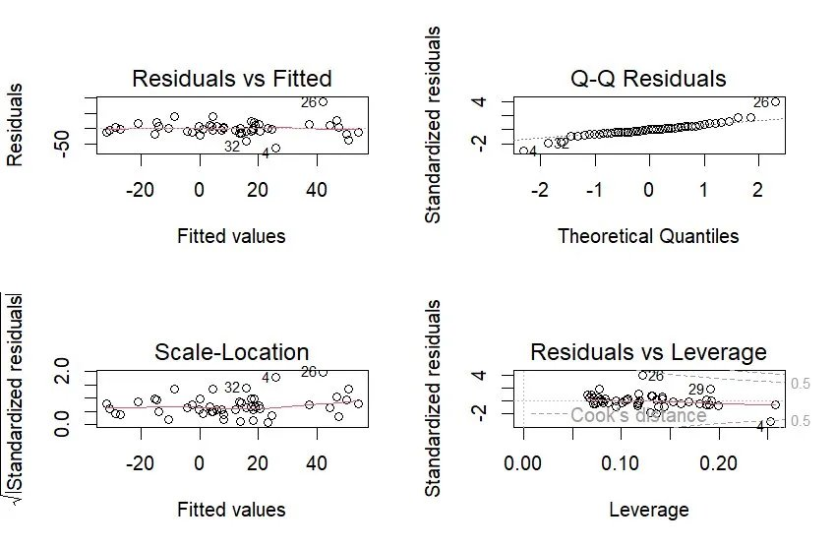
Model Assumption Checks — Full OLS Model
Diagnostic Plots — Full Model
1. Normality
⚠ Mild
Shapiro-Wilk: W=0.911, p=0.0015 → Reject H₀. QQ plot shows tail departures (Nevada, CA). Mild violation; bulk of residuals normal.
2. Homoscedasticity
✓ OK
Breusch-Pagan: LM=21.87, p=0.057. Scale-Location plot is roughly flat → borderline. Fail to reject H₀ at α=5%.
3. Autocorrelation
✓ OK
Durbin-Watson: DW=2.215, p=0.486. No serial autocorrelation in residuals. Cross-sectional data — expected.
Residuals, Histogram & Cook's D
4. Multicollinearity
✓ OK
All Adj. VIF < 4 (max=3.83, Temp). No problematic multicollinearity despite bivariate inter-predictor correlations.
5. Influential Obs.
✓ OK
Cook's D: max=0.66 (Obs 4, CA). No obs exceeds threshold of 1.0. Obs 26 (Nevada) and Obs 29 (NY) flagged for leverage.

Slide 13
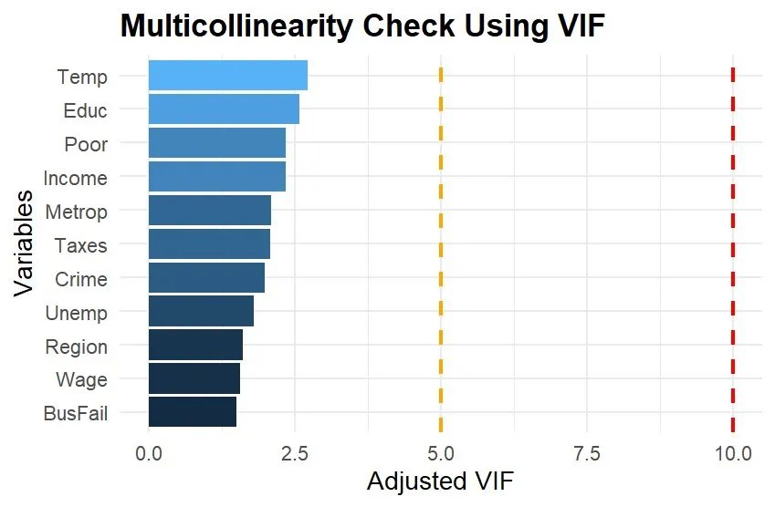
Multicollinearity (VIF) & Influential Observations Detail
Adjusted VIF — All Predictors (threshold: 5 = orange, 10 = red)
Variable | GVIF | df | Adj. VIF
Temp | 14.68 | 1 | 3.83
Educ | 13.91 | 1 | 3.73
Region | 15.84 | 1 | 1.99
Poor | 12.07 | 1 | 3.47
Income | 11.07 | 1 | 3.33
Taxes | 10.04 | 1 | 3.17
Metrop | 5.40 | 1 | 2.32
Crime | 4.43 | 1 | 2.11
Unemp | 3.11 | 1 | 1.76
Wage | 2.82 | 1 | 1.68
BusFail | 2.65 | 1 | 1.63
VIF Verdict
Full model: All Adj. VIF < 4 (max Temp=3.83). Stepwise model VIF: Income (Adj. VIF=1.40), Poor (Adj. VIF=1.40), Region (Adj. VIF=1.07) — all extremely low. No multicollinearity concern in either model.
Influential Obs
Obs 4 (CA): Cook's D = 0.66 — most influential but < 1.0. Obs 26 (NV): extreme response outlier (+128.5), D = 0.29. Obs 29 (NY): high leverage but low Cook's D. No removal needed.

Slide 14
Outlier Detection & Removal
9
Outliers Identified — States 4, 26, 29, 30, 32, 45
Studentized Residuals
Cook's Distance
States 4 & 26 exceed |2|: values −4.02 and +4.78 respectively — extreme regression outliers.
States 4, 26, 29, 30, 32, 45 exceed the 4/n threshold — influential on regression coefficients.
Hat Values (Leverage)
DFFITS
State 30 has hat value 0.687 > 2p/n = 0.58 — high leverage point with extreme predictor values.
States 4 (|−3.66|) and 26 (|+2.59|) show extreme influence on fitted values when removed.
WHY We Remove Outliers
✓ Outliers violate the normality assumption of MLR residuals (Shapiro-Wilk p=0.0015 < 0.05 with outliers).
✓ Influential points (high Cook's D) distort regression coefficients, leading to biased and unreliable estimates.
✓ Removing confirmed influential outliers improved model fit: R² rose from 0.518 → 0.783, RSE dropped 25.67 → 13.7.
✓ Post-removal Shapiro-Wilk: W=0.988, p=0.935 — residuals now follow normal distribution (assumption satisfied).
Determinants of Domestic In-Migrants | PRMSS Statistics Sem II | 2025–26

Slide 15
Refined Model: New Data (n=42), Summary & ANOVA
10
After removing 6 outliers (obs. 4, 26, 29, 30, 32, 45) — Full model refit on 42 states
R²
Adj. R²
F-statistic
RSE
0.783
0.683
7.792
13.7
Explains 78.3% of variance
Strong after adjustment
p = 3.1×10⁻⁶ — Highly significant
Much improved from 25.67
ANOVA Table — New Data Full Model
Source | Df | Sum Sq | Mean Sq | F-value | p-value | Sig.
Unemp | 1 | 1360.5 | 1360.5 | 7.25 | 0.0118 | *
Wage | 1 | 2093.4 | 2093.4 | 11.16 | 0.0024 | **
Crime | 1 | 58.9 | 58.9 | 0.31 | 0.5798
Income | 1 | 2265.7 | 2265.7 | 12.08 | 0.0017 | **
Metrop | 1 | 356.1 | 356.1 | 1.90 | 0.1792
Poor | 1 | 467.5 | 467.5 | 2.49 | 0.1257
Taxes | 1 | 2099.3 | 2099.3 | 11.19 | 0.0024 | **
Educ | 1 | 1419.9 | 1419.9 | 7.57 | 0.0103 | *
BusFail | 1 | 208.6 | 208.6 | 1.11 | 0.3007
Temp | 1 | 511.0 | 511.0 | 2.72 | 0.1100
Region | 3 | 8164.7 | 2721.6 | 14.51 | 6.9×10⁻⁶ | ***
Residuals | 28 | 5253.4 | 187.6 | — | —
Determinants of Domestic In-Migrants | PRMSS Statistics Sem II | 2025–26

Slide 16
Model Assumptions — After Outlier Removal (n=42)
11
Normality of Residuals
✓ SATISFIED
Method: Shapiro-Wilk Test | Result: W = 0.9881, p = 0.9346
p >> 0.05: residuals are normally distributed. Assumption fully satisfied after removing influential outliers.
Homoscedasticity
✓ SATISFIED
Method: Breusch-Pagan Test | Result: BP = 13.218, df = 13, p = 0.4311
p = 0.43 >> 0.05: no evidence of heteroscedasticity. Variance of residuals is constant.
Independence of Residuals
✓ SATISFIED
Method: Durbin-Watson Test | Result: DW = 1.9858, p = 0.4484
DW ≈ 2.0 with p = 0.45: no significant autocorrelation in residuals.
All three core MLR assumptions are now satisfied — the refined model is statistically valid.
Determinants of Domestic In-Migrants | PRMSS Statistics Sem II | 2025–26

Slide 17
Stepwise AIC Regression — Selected Model & Interpretation
12
Best Model (AIC = 221.23): NDIR ~ Unemp + Income + Poor + Educ + BusFail + Region
R²
Adj. R²
F-statistic
p-value
0.781
0.728
14.74
6.8×10⁻⁹
Selected Predictors & Coefficients
Interpretation of Key Coefficients
Predictor | Estimate | p-value | Sig.
(Intercept) | 188.1 | 0.016 | *
Unemp | −4.556 | 0.077 | .
Income | −0.00186 | 0.013 | *
Poor | −2.222 | 0.052 | .
Educ | −1.177 | 0.196
BusFail | 58.31 | 0.024 | *
RegionNE | −19.59 | 0.041 | *
RegionSouth | +14.06 | 0.063 | .
RegionWest | +43.33 | 6.3×10⁻⁷ | ***
Income (−):
For every $1 increase in per capita income, NDIR decreases by 0.00186 — wealthier states lose migrants.
BusFail (+):
A 1-unit rise in business failure rate increases NDIR by 58.3 — distressed business environments attract migrants seeking opportunity elsewhere.
RegionWest (+++):
Western states have on average 43.3 more NDIR than Midwest baseline — strong pull factor.
RegionNE (−):
Northeastern states have ~19.6 lower NDIR than Midwest — push-out of population.
Unemp (−):
Higher unemployment repels in-migrants; each 1% rise reduces NDIR by ~4.56.
Poor (−):
Higher poverty rates discourage in-migration; states with high poverty see less influx.
Determinants of Domestic In-Migrants | PRMSS Statistics Sem II | 2025–26

Slide 18
Stepwise ANOVA & Model Comparison
13
Stepwise Model ANOVA
ANOVA: Stepwise vs Full Model
Source | Df | F-value | p-value | Sig.
Unemp | 1 | 8.46 | 0.0064 | **
Income | 1 | 24.19 | 2.3×10⁻⁵ | ***
Poor | 1 | 1.23 | 0.2763
Educ | 1 | 3.00 | 0.0927 | .
BusFail | 1 | 1.72 | 0.1983
Region | 3 | 26.43 | 6.7×10⁻⁹ | ***
Residuals | 33 | — | —
Model | Res.Df | RSS
Stepwise (Model 1) | 33 | 5305.8
Full (Model 2) | 28 | 5253.4
Difference | −5 | +52.4
F = 0.056, p = 0.998 — Full model NOT significantly better than stepwise.
Comprehensive Model Comparison
Metric | Original Full (n=48) | New Full (n=42) | Stepwise (n=42)
n (observations) | 48 | 42 | 42
Predictors | 13 (p) | 13 (p) | 8 (p)
R² | 0.518 | 0.783 | 0.781
Adjusted R² | 0.334 | 0.683 | 0.728
RSE | 25.67 | 13.70 | 12.68
AIC | Higher | 230.82 | 221.23 ✓
F-stat p-value | 0.0078 | 3.1×10⁻⁶ | 6.8×10⁻⁹
Normality (S-W) | Violated | p=0.935 ✓ | p=0.935 ✓
Determinants of Domestic In-Migrants | PRMSS Statistics Sem II | 2025–26

Slide 19
Conclusions & Limitations
14
KEY CONCLUSIONS
LIMITATIONS
✦ Region is the strongest determinant of in-migration; Western states have the highest attraction (β=+43.3, p<0.001).
⚠ Cross-sectional
Single time-point data cannot capture temporal trends or causality in migration.
✦ Income negatively affects NDIR — wealthier states experience net out-migration of lower-income migrants.
⚠ Omitted Variables
Factors like housing cost, amenities, political climate not included.
✦ Business failure rate (BusFail) surprisingly shows a positive effect, possibly capturing economic dynamism.
⚠ Outlier Removal
✦ Poverty and unemployment are significant deterrents to in-migration, as economically vulnerable states attract fewer migrants.
Removing 6 states (12.5% of data) may reduce generalizability.
⚠ Linearity
✦ The stepwise model (8 predictors) is as good as the full model (13 predictors) — F-test confirms parsimony.
Assumes linear relationships; non-linear effects may exist.
✦ After removing 6 outliers, model quality improved dramatically: R² 0.518→0.783, all assumptions met.
⚠ Sample Size
n=42 is moderate; larger samples would improve power.
✦ RegionNortheast shows a significant negative coefficient — population is moving out of northeastern states.
⚠ Endogeneity
Some predictors (income, taxes) may be influenced by migration itself.
Determinants of Domestic In-Migrants | PRMSS Statistics Sem II | 2025–26

Slide 20
Future Scope
Directions for Further Research
01. Longitudinal Panel Data Analysis
02. Non-Linear & Machine Learning Models
03. Geographic & Spatial Models
Extend to multi-year panel data to track migration trends over time and establish causality using fixed-effects or random-effects models.
Explore Random Forest, Gradient Boosting, or polynomial regression to capture non-linear relationships and improve prediction accuracy.
Apply spatial regression (Moran's I, SAR, SEM) to account for spatial autocorrelation between neighboring states.
04. Additional Predictors
05. State-Level Policy Simulations
06. Sub-Group Analysis
Include housing affordability index, cost of living, healthcare access, climate change indices, and political governance scores.
Use the model to simulate how policy changes (tax cuts, job creation) would affect in-migration rates for targeted intervention.
Disaggregate NDIR by age group, income bracket, and education level to study heterogeneous migration motives.
Thank You | Shubham Chavan (2514) • Tejal Takir (2553) • Prajyukta Gaikwad (2518) | PRMSS Statistics Sem II 2025-26

